Slide 1
COMP SCI 1103/2103 Algorithm Design & Data Structure Polymorphism and Summary of OOP Concepts
School of Computer Science

Slide 2
Review
Inheritance
Three accessibility keywords
Friend
Overloading functions
Multiple Inheritance
Virtual keyword
By the way! You don’t need to work with c-strings anymore in this course. Work with “string”s which is more advanced library in c++
http://www.cplusplus.com/reference/string/string/
Few more minutes on ambiguity…

Slide 3
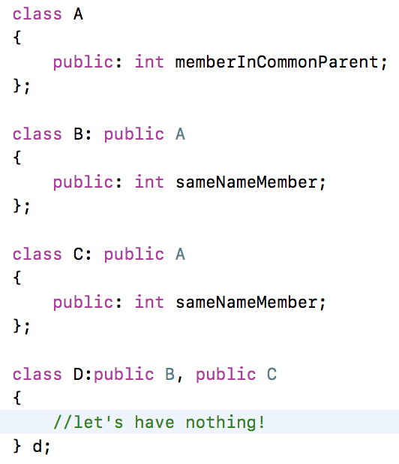
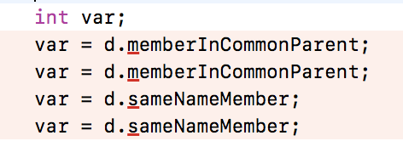
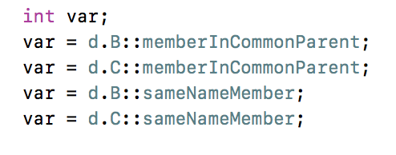
Ambiguity on Multiple Inheritance
Use virtual inheritance for fixing this ambiguity

Slide 4
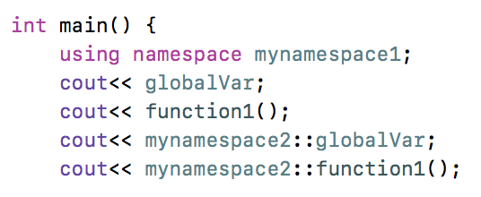
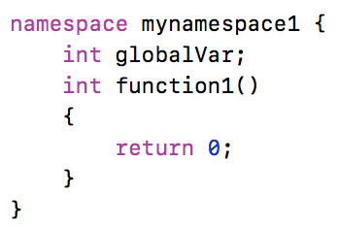
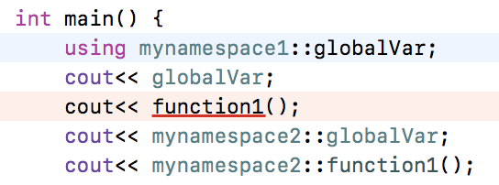
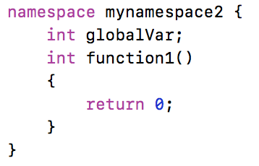
Ambiguity on defined names
Names must be unique in their space.
You can declare namespaces to provide a scope for variables
Note how the scope resolution operator (::) is used.

Slide 5
This session
Polymorphism
Overriding
Redefining
Which version of the function should be called?!

Slide 6
Polymorphism
What is Polymorphism?
The provision of a single interface to entities of different types (From Wikipedia!)
We need to associate multiple meanings with one function name.
In what ways can we do this in C++?
Notes:
Late/dynamic binding

Slide 7
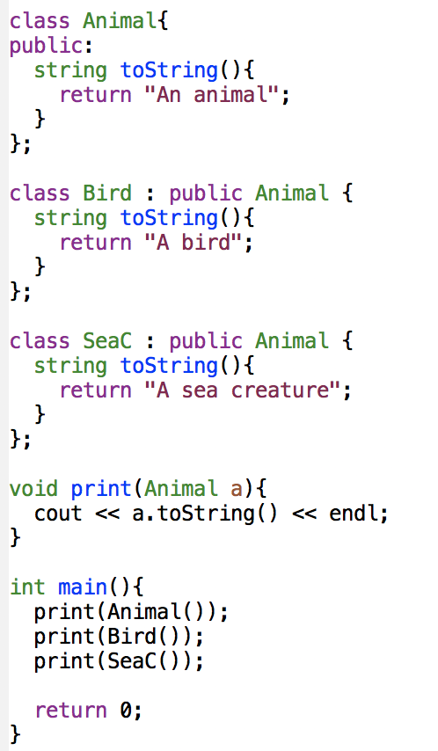
Compile-time checking
How is it compiled?
What do we need?
Here, the C++ compiler decides which function to call before the program starts running.
This is Redefinition (note that it uses compile-time checking).
There’s another way: run-time checking.
Notes:
The compiler makes the decision during compilation
Matching a function signature and binding a function implementation are two separate issues. The declared type of the variable decides which function to match at compile time. The compiler finds a matching function according to parameter type, number of parameters and the order of the parameters.

Slide 8
Run-time checking
C++ uses a mechanism called late binding or dynamic binding to determine which version of a function it calls at any particular time.
This happens when the code is being executed and the system can determine which function to call, based on the subclass that is being used.
This allows us to really use polymorphism.
Notes:
Virtual functions are the way c++ provides late binding

Slide 9
The virtual keyword and the process
How is it done in c++?
Declare the function in the parent class with keyword “virtual” virtual int test(int n, int acc);
C++ makes a virtual table for that class.
The table is copied for a child class, and the addresses are overridden, as the functions are re-implemented in child. At compile time.
Whenever an object of one of child class is constructed, a pointer to the table of that class is also stored in it.
Which code to execute? Decided at runtime.
Notes:
A virtual function is one that, in some sense, may be used before it is defined.

Slide 10
Overloading, Overriding & Redefining
They are all based on sharing the same function name.
Overloaded functions
Same function name but different parameter list
Quite irrelevant to our topic today!!
Redefined functions
Same function signature but different implementation in derived and based classes. Called in the same way as ordinary functions.
Overridden functions
Virtual keyword
Same function signature but different implementation in derived and based classes. Call by a reference to the virtual method table: Which function to call? decided at runtime
Notes:
Overload : must have different parameter lists. The compiler makes the decision based on the arguments used
Redefined : compiler decides based on the static type of the object reference rather the actual type of the object
Overridden: redefining a virtual function in a derived class is called overriding a function

Slide 11
The virtual keyword
If you make something virtual in the base class, it is automatically virtual when declared in the children. (It would be better to still label it virtual).
You add the reserved word virtual to the declaration, not the implementation.
When we change a virtual function’s implementation, we are overriding. If we change the definition without virtual, it’s redefining.

Slide 12
The virtual keyword
If virtual functions are so handy, why not use them for all member functions?
Efficiency! your program risks being a lot slower if you use it for everything.
It’s a lot more work to correctly track virtual functions.
Notes:
The compiler and the run-time environment need to do much more work for virtual functions

Slide 13
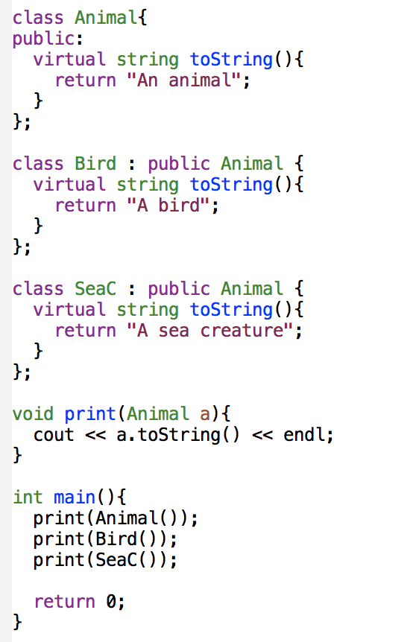
Example
Does the virtual keyword solve our problem?

Slide 14
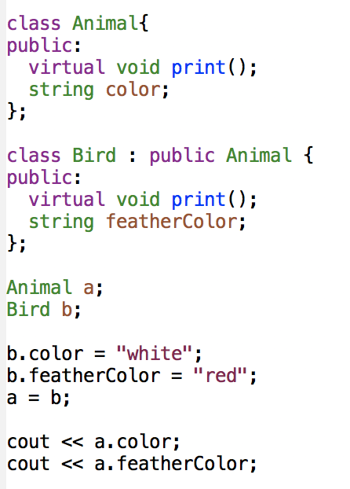
The slicing problem
We can assign an instance of the derived class to a variable of parent class.
But we ‘slice off’ the added fields and functions.
What does this code print?
We can use pointers to get it right.
Notes:
Although it is legal to assign a derived class object to a base class variable, the assignment slices off data.
Any data members and functions only in the derived class will be lost or unvavilable.

Slide 15
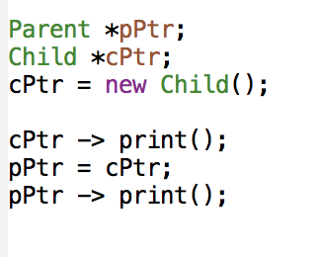
Pointers to instances
We have a Parent and a Child.
Child has an additional variable, addField.
They share a virtual print() function, that the Child class overrides:
Late binding happens!

Slide 16
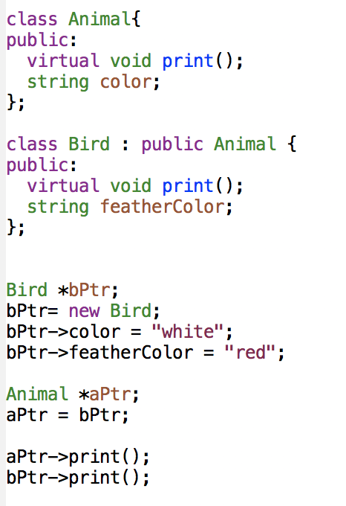
Example

Slide 17
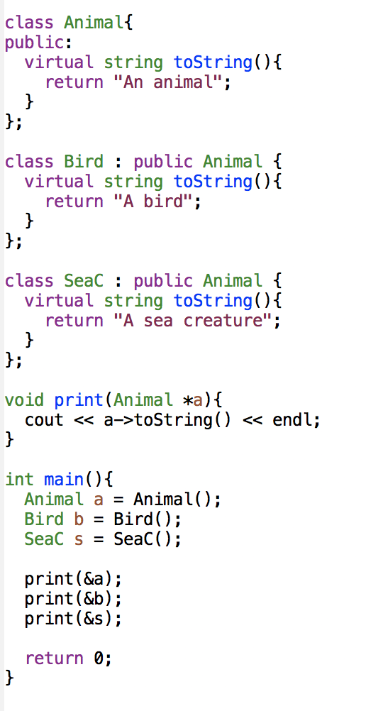
Example
Which virtual keyword is necessary (if any) if we want this to output: “An animal A bird A sea creature”?
What will be the output if we remove the keyword virtual?

Slide 18
Dynamic binding
To enable late/dynamic binding for a function, we need to guarantee:
The function must be declared with the virtual keyword in the base class.
The variable that references the object for the function must contain the address of the object

Slide 19
Summary
We covered polymorphism.
You should now know the difference between overloading, redefining and overriding.
You should also understand the different roles of compile-time and run-time checking, as well as what dynamic or late binding means.

Slide 20
Notes:
Save as a PowerPoint Show and upload to your MyUni course.
Before you upload the PPS customise slides and indicate where students will find them.

